Slide 1
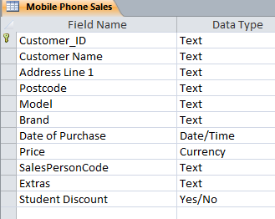
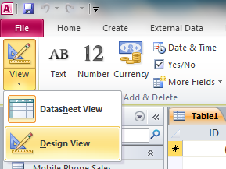

Microsoft Access:
1) Open Access and Save a New Database File – Call the File – Sales Database 2) Create a New table called “Mobile Phone Sales” Include the Fields and Data Types Shown on the Right
You need to be in Design View

Slide 2
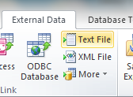
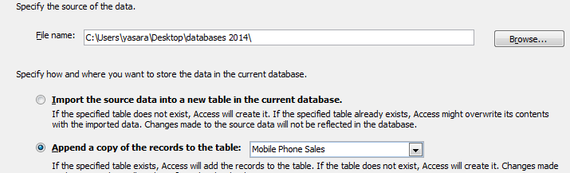
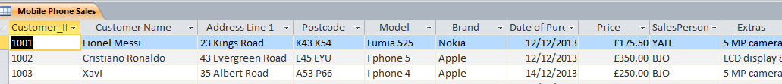
Importing CSV
The manager at the mobile shop has transferred all the sales data into a CSV File. Your Task is to attach the CSV file to your newly created database.
3) Click on External Data >> Text File 4) Browse for the CSV File and then click the option >> Append a copy of the records to the table. 5) The click Next and Finish to complete the Import.
1
2

Slide 3
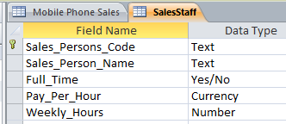
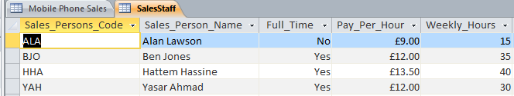
Creating Sales Person Table
6) You have to create a new table for your sales assistants (SalesStaff): You have to include the following fields: Sales_Persons_Code Sales_Person_Name Full_Time Pay_Per_Hour Weekly_Hours
7) Add the following records:

Slide 4
Creating Sales Person Table
8) Create a one to many relationship using the key fields:

Slide 5
Query and Report
9) Create a report for the phones which are part of sale promotion. Contains a new field called Sale_Price which is calculated at run-time. 10% needs to be taken off the Price Shows only the records where the brands are Nokia or Apple and the camera is 5mp. All models apart from Lumia 525 Shows only the fields Customer Name, Address Line 1, Model, Brand, Price, Sales_Person_Name, Full_Time and Sale_Price Fits on a single page wide Has a page orientation of landscape Sorts the data into ascending order of Customer Name Calculates the total number of phone sales with an appropriate label and place it at the bottom of the report. Includes the heading Discounted Phone Sales at the top of the page Has your name on the right in the page footer. Has your candidate number in the report footer.

Slide 6
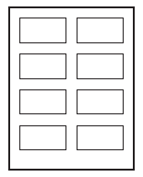
Label
10) You are going to prepare labels for the company. Produce labels from all the data which: Arrange labels in two columns. Only include phones which were sold in December 2013. Show only the fields Customer_Name, Address Line 1, Model, Brand, Date of Purchase and Price each on a separate line. Display the field name as well as the data In a larger font, at the top of each label, include the heading: December 2013 Sales Include your name at the bottom of each label.

Slide 7
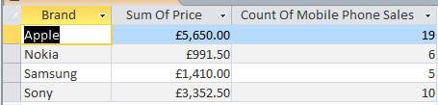
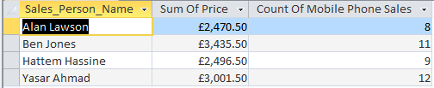
Summery Queries
11) Brand & Sum of Price Show only the Brand and Price Calculates the total value of these sales for each Brand Counts the number of these phones sold for each Brand. 12) Brand & Price Show only the Sales Person and Price Calculates the total value of these sales for each Sales Person Counts the number of these phones sold for each Sales Person.

